Slide 1
Socially aware motion planning of assistive robots in crowded environments
Alessio Colombo
DISI – University of Trento
Advisor: Prof. Luigi Palopoli

Slide 2
Outline
Introduction
Motivations
Cognitive engine
Long term planner
Identification of human models
Short term planner
Experiments
Conclusions

Slide 3
Outline
Introduction
Motivations
Cognitive engine
Long term planner
Identification of human models
Short term planner
Experiments
Conclusions

Slide 4






Introduction
In Europe there are more than 80 million people with disabilities
Mobility impairments
Require assistance
of caregivers
Total or partial visual or hearing
impairments
Dementia
(e.g., Alzheimer’s)
This is over 15% of the whole population
Source: http://www.edf-feph.org/Page_Generale.asp?DocID=12534

Slide 5
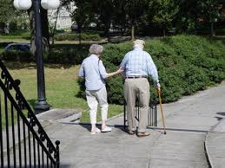
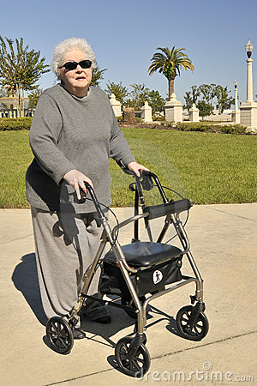

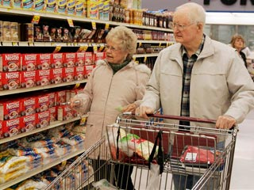

Introduction
The majority of them are elderly
Reduced abilities transform simple tasks in challenging ones
Isolation, depression and malnutrition are possible consequences
J. Van Cauwenberg, et al., “Environmental factors influencing older adults’ walking for trans- portation: a study using walk-along interviews” Int J Behav Nutr Phys Act, vol. 9, no. 1, p. 85, 2012

Slide 6
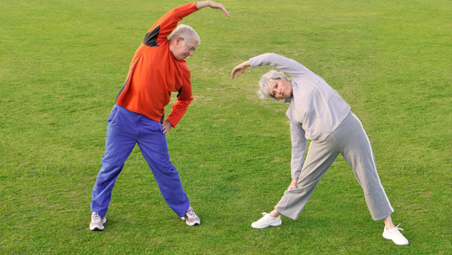
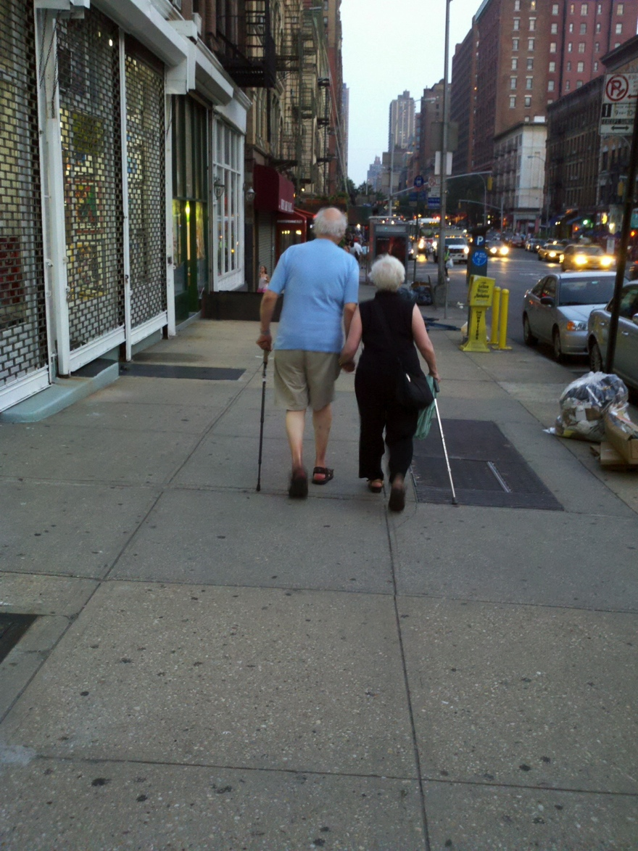

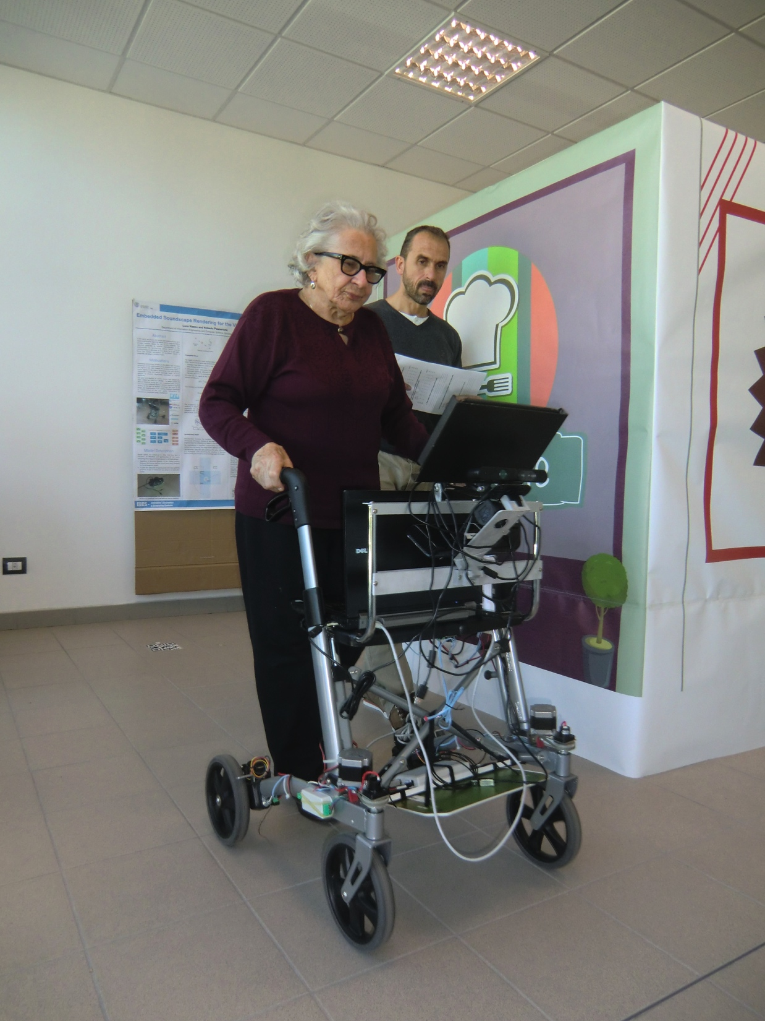
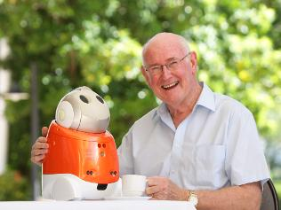
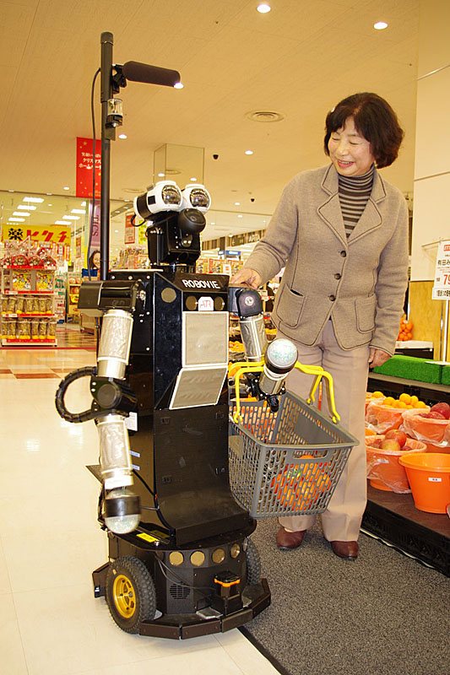
Introduction
Physical activity is proven to be beneficial and can decelerate the process of ageing
Assistive robots can be of great help
Amplify beneficial effects
Compensate impairments
D. E. Warburton, et al., “Health benefits of physical activity: the evidence”, Canadian medical association journal, vol. 174, no. 6, pp. 801–809, 2006.
D. Feil-Seifer and M. Mataric, “Defining socially assistive robotics”, in Rehabilitation Robotics, 2005. ICORR 2005, pp. 465–468, June 2005.

Slide 7

Introduction
Autonomous assistive robots need to:
Satisfy user’s need
Understand what is happening around them and behave accordingly
We need to talk about social rules!
C. Bartneck and J. Forlizzi, “A design-centred framework for social human-robot interaction”, in Robot and Human Interactive Communication, 2004. ROMAN 2004. 13th IEEE International Workshop on, pp. 591 – 594, September 2004.

Slide 8
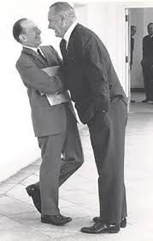
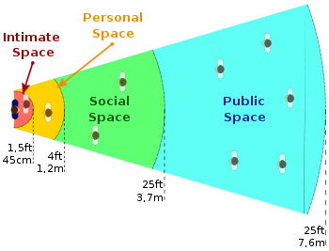
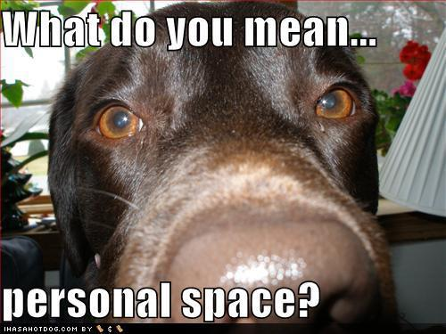

Introduction
Social rules:
Non-written rules managing cohabitation of people.
Strictly personal and cultural dependent.
Proxemics
E. T. Hall, “Proxemics – the study of man’s spatial relations”, in Man’s image in medicine and anthropology, International Universities Press, 1962.

Slide 9


Introduction
Design a “cognitive engine” for assistive robots
Safely drive assistive robots in indoor crowded environments
Obey social rules
Consider user’s goals and preferences

Slide 10

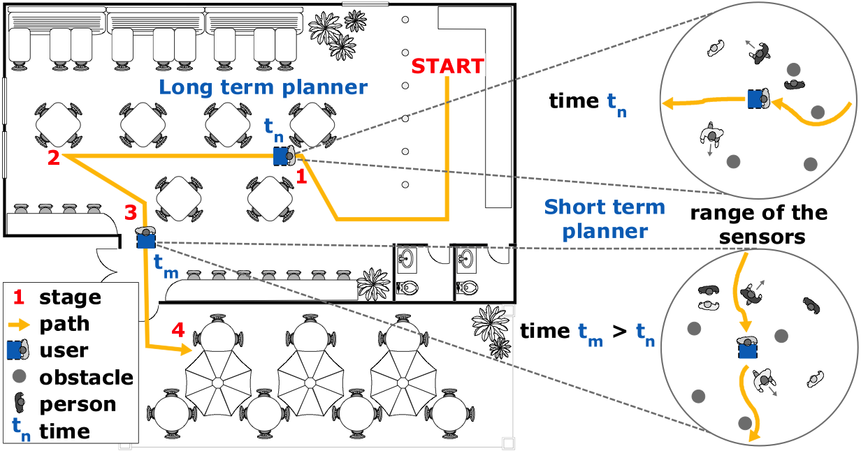
Introduction
A “cognitive engine” is a set of decision algorithms:
Uses onboard and environmental sensors
Suggests the user the best path towards her goals, knowing the state of the environment
Two-level hierarchical approach combining
long term and short term planners

Slide 11
Outline
Introduction
Motivations
Cognitive engine
Long term planner
Identification of human models
Short term planner
Experiments
Conclusions

Slide 12
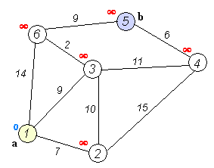



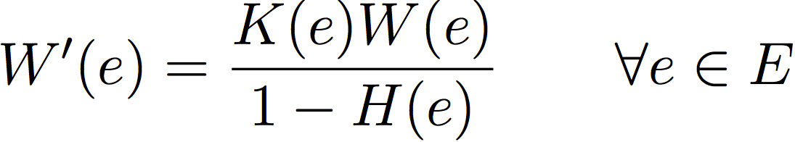

Long term planner
Based on Dijkstra’s algorithm
Weights:
Constraints
Euclidean distance
Animation courtesy of Wikipedia.com
Heat maps

Slide 13
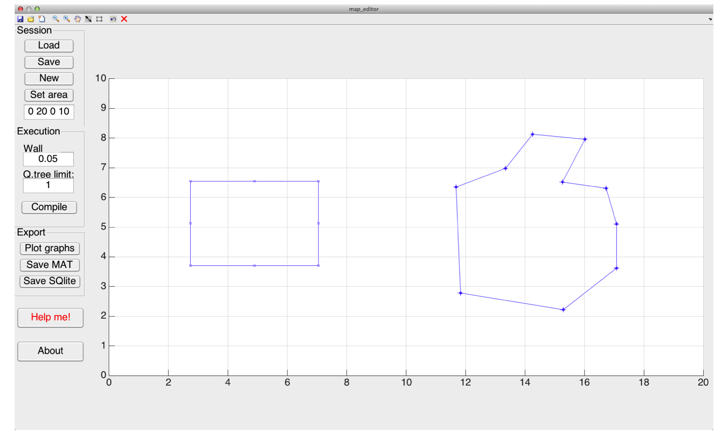
Long term planner
Implementation:
MATLAB map designer
MATLAB + Java simulator
Test and validate algorithm by means of simulations

